Slide 1

Title
A Guide To Raising Capital Efficiently In The Shortest Amount Of Time Possible Regardless Of Industry, Region, Stage Or Deal Type In All Market Conditions
Progressor Media

Slide 2
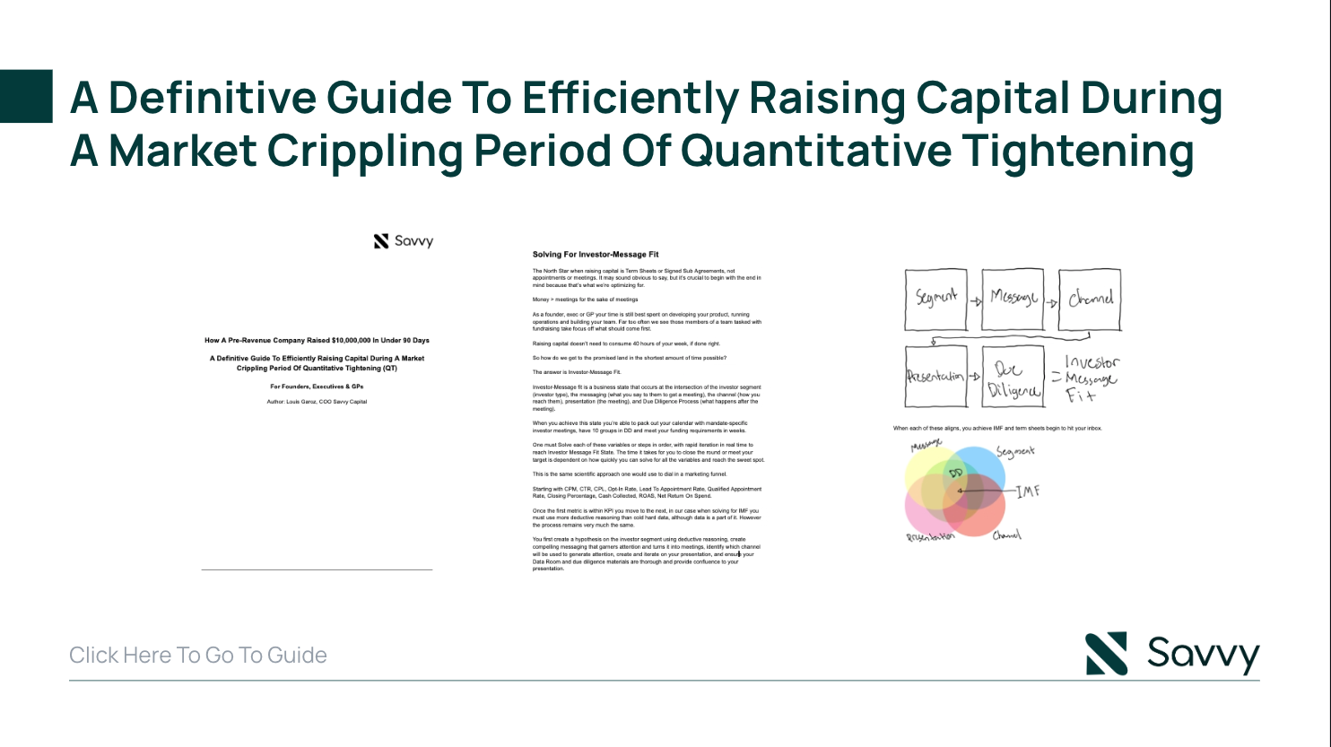
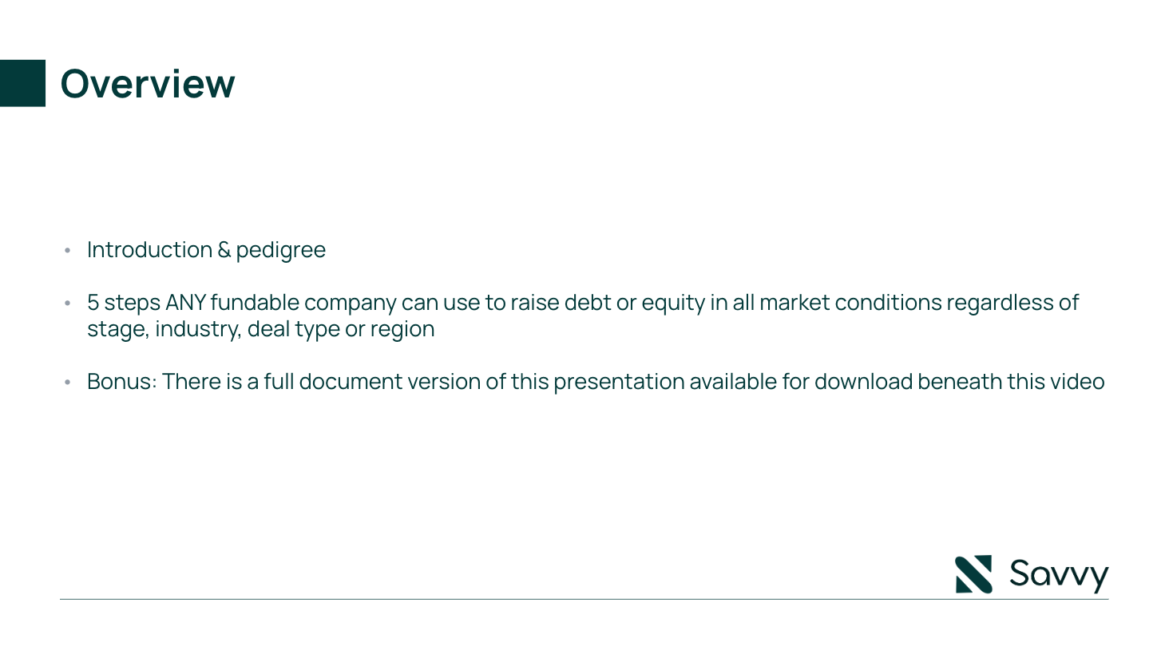

Overview

Slide 3

A Guide To Raising Capital Efficiently In The Shortest Amount Of Time Possible

Slide 4
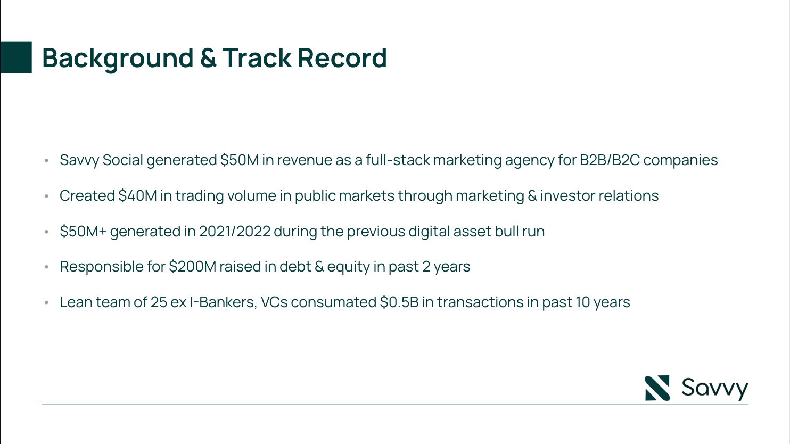
With a background in SaaS, Venture Capital, Digital Transformation, Defense and Pharma, Standard Demand Partners accelerates businesses in the capital markets with large scale marketing campaigns.
Lean team of 15 ex I-Bankers, VCs consummate $0.5B in transactions in past 10 years
Most recently helped SaaS startup raise valuation to $2M in 2024

Slide 5
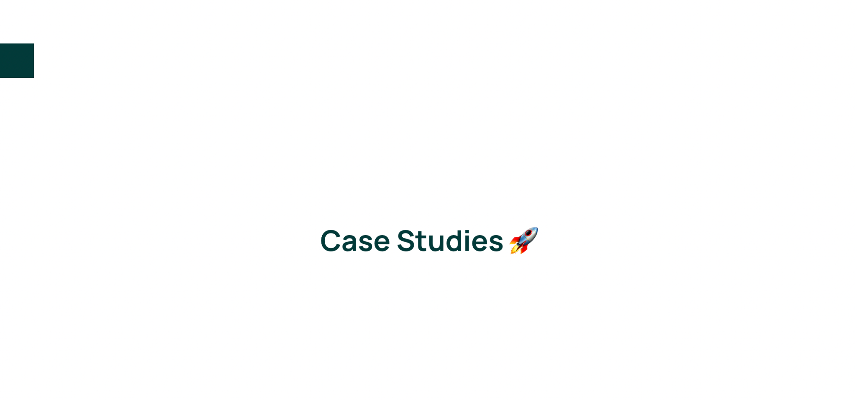

Slide 6
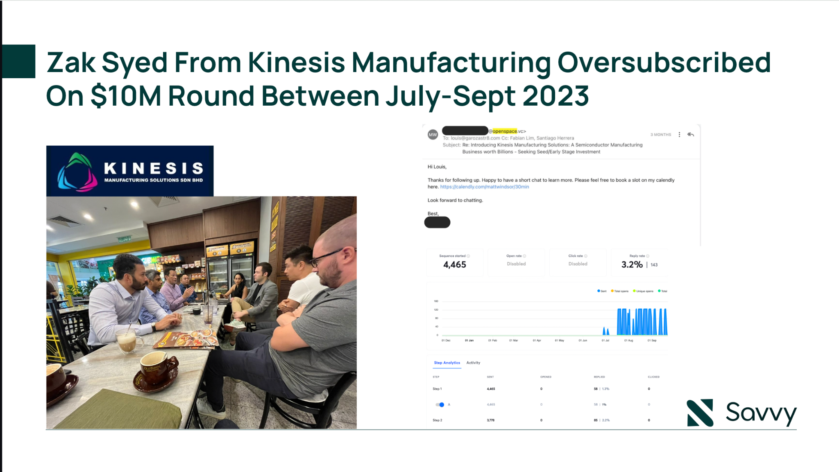

Slide 7
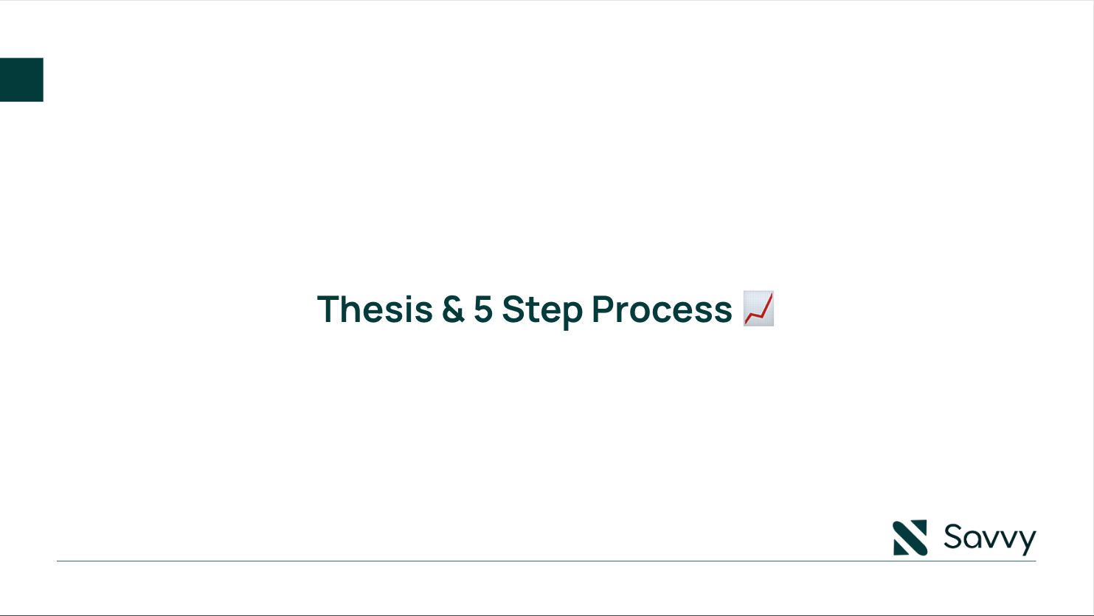

Slide 8
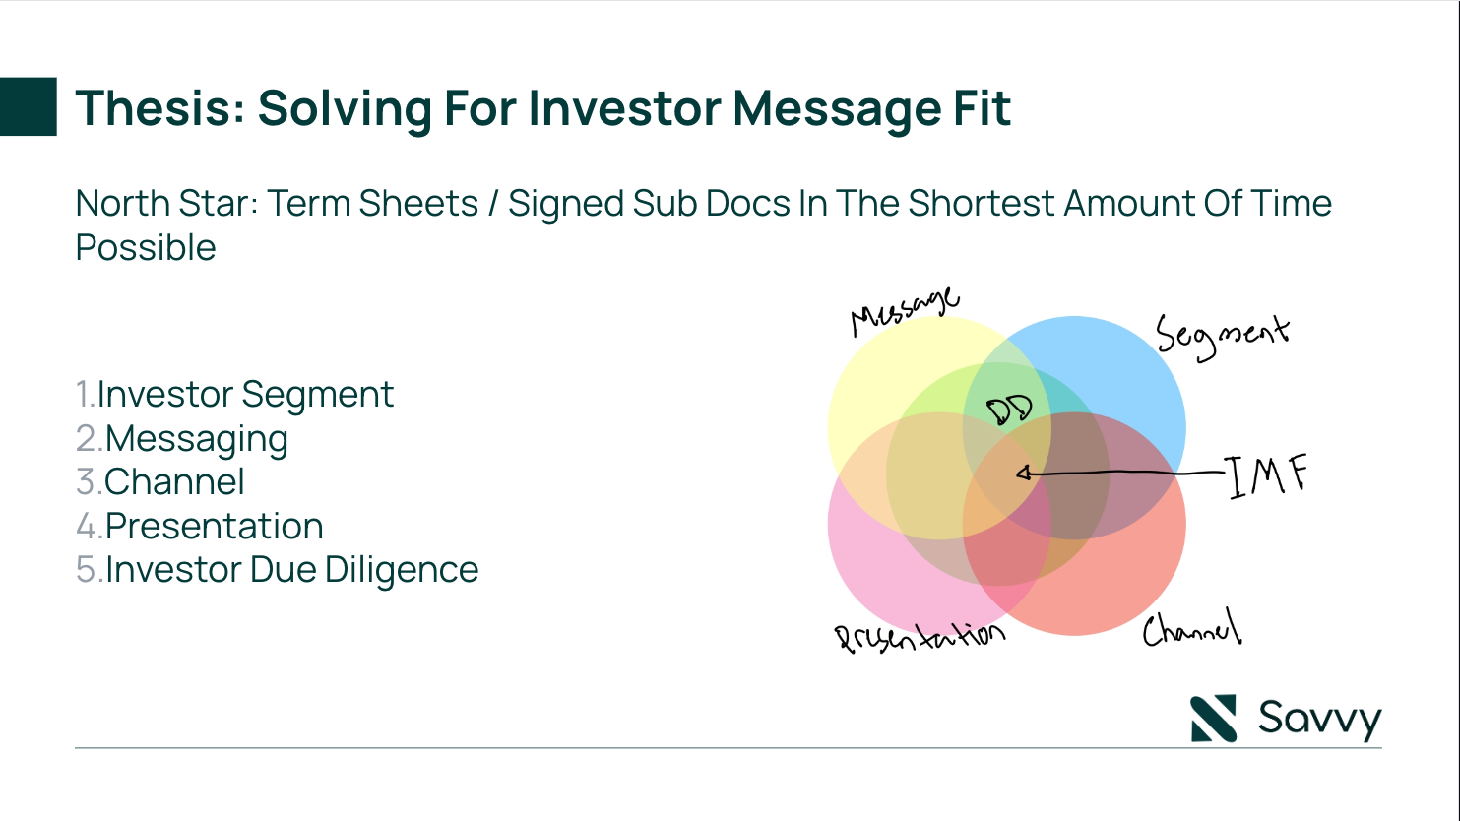

Slide 9
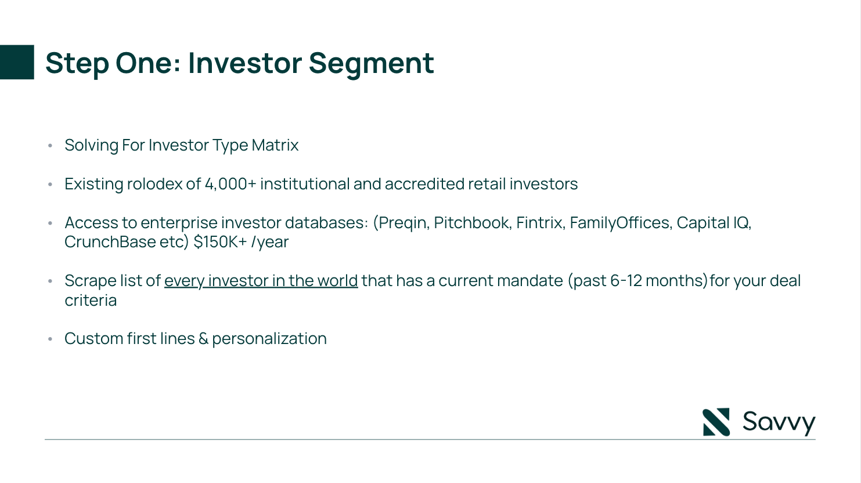

Slide 10
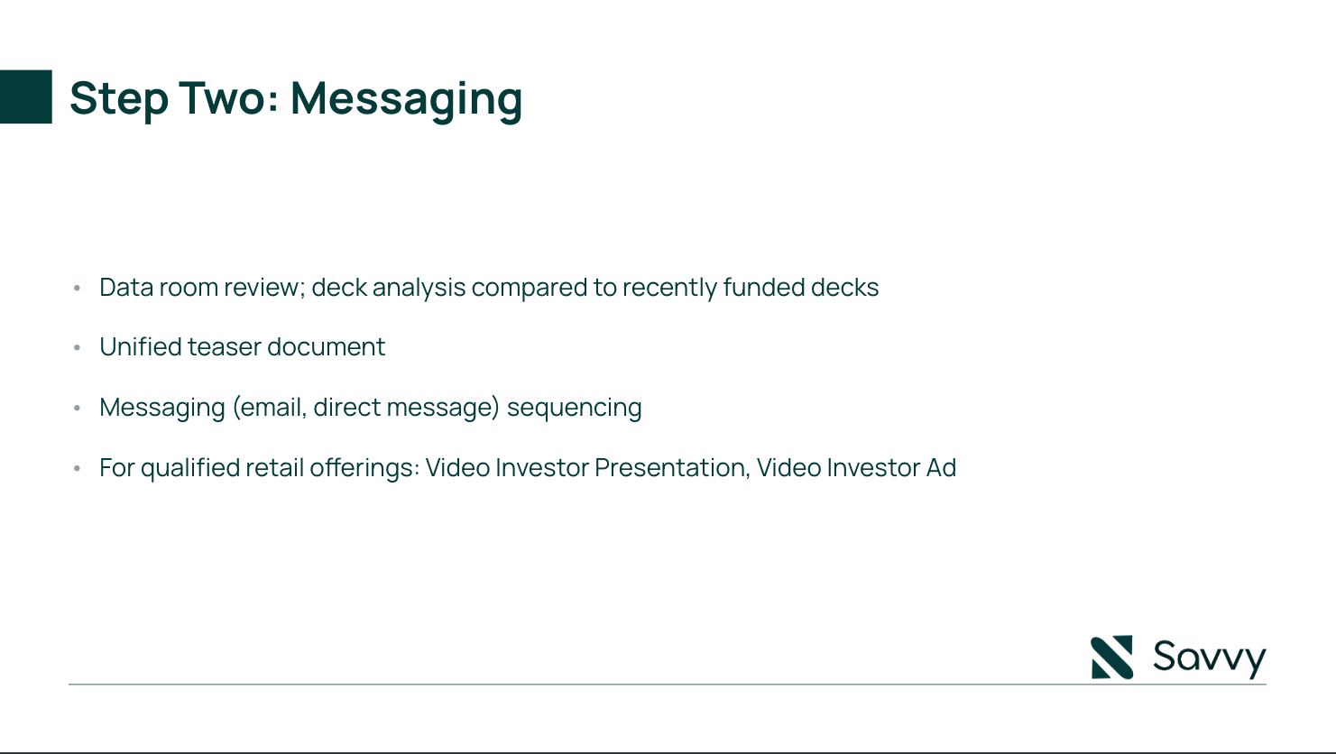

Slide 11
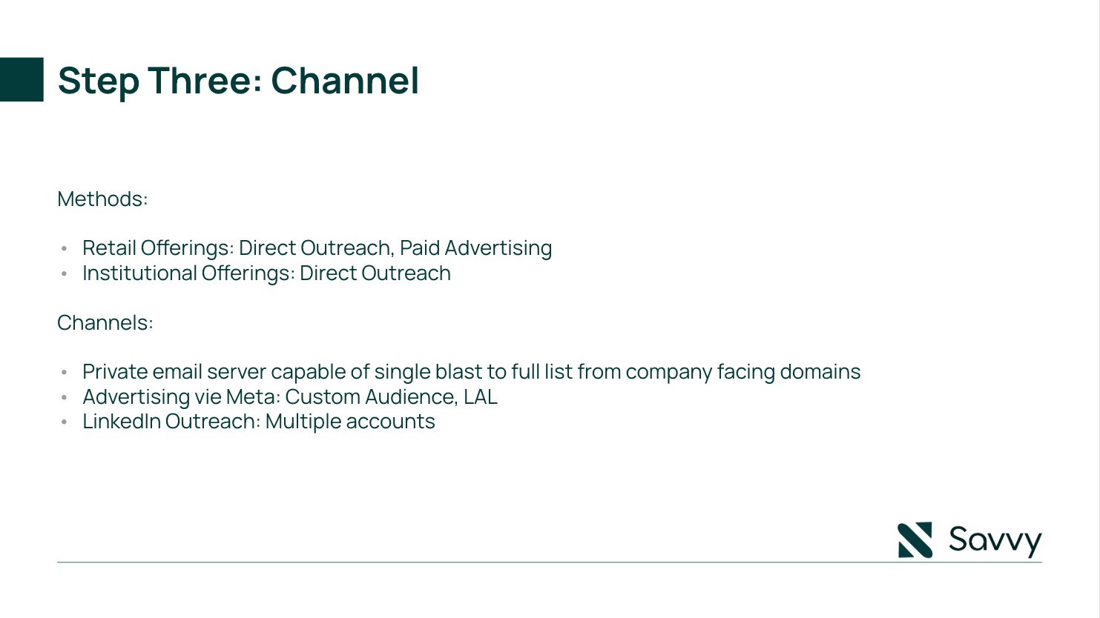

Slide 12
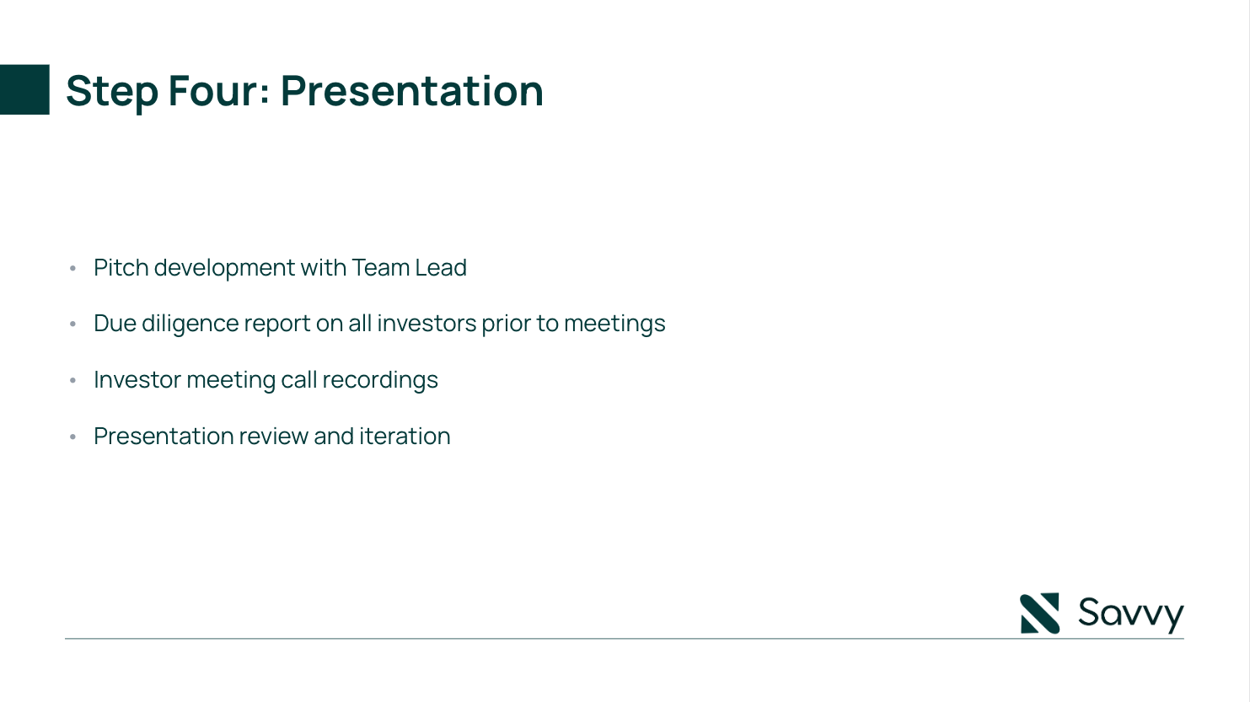

Slide 13
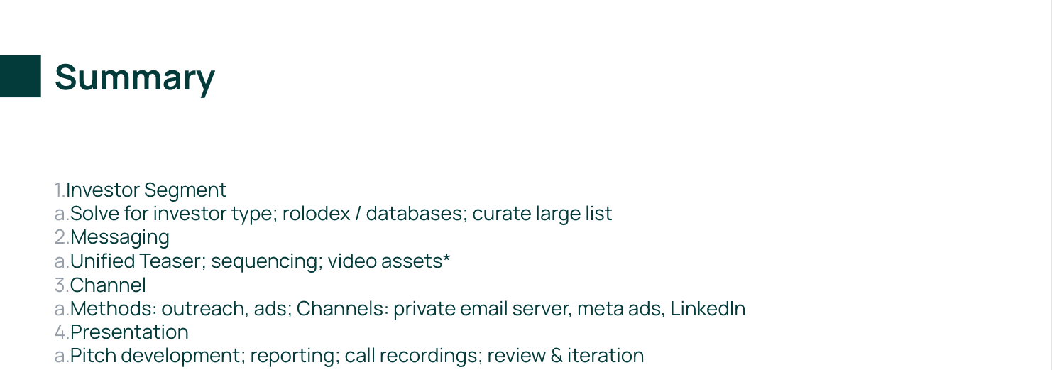

Slide 14
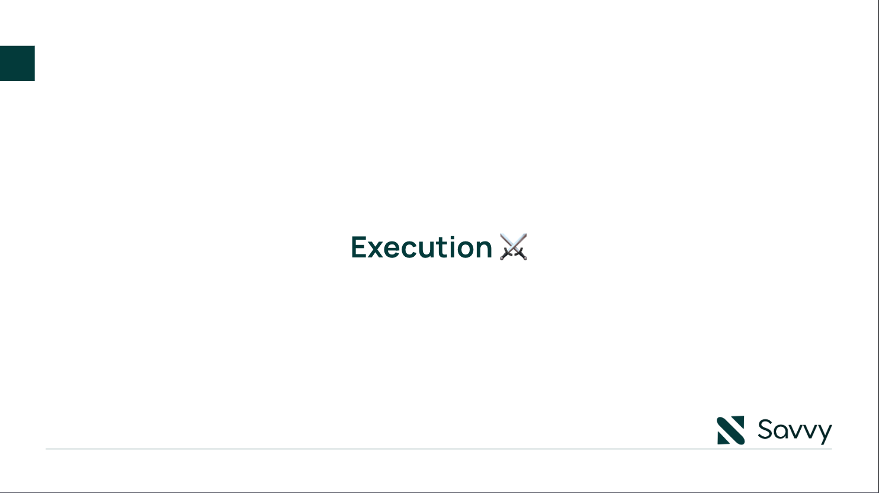

Slide 15
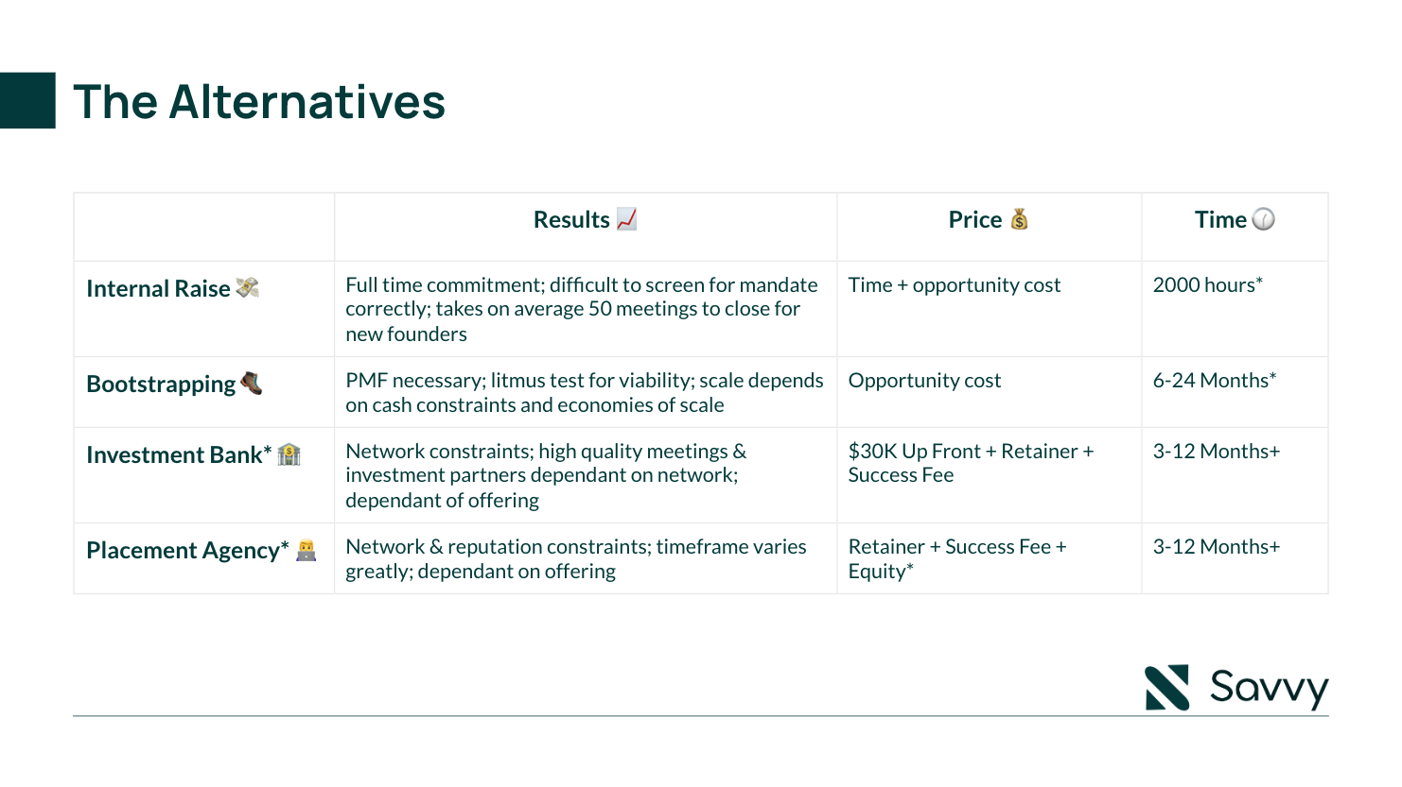

Slide 16
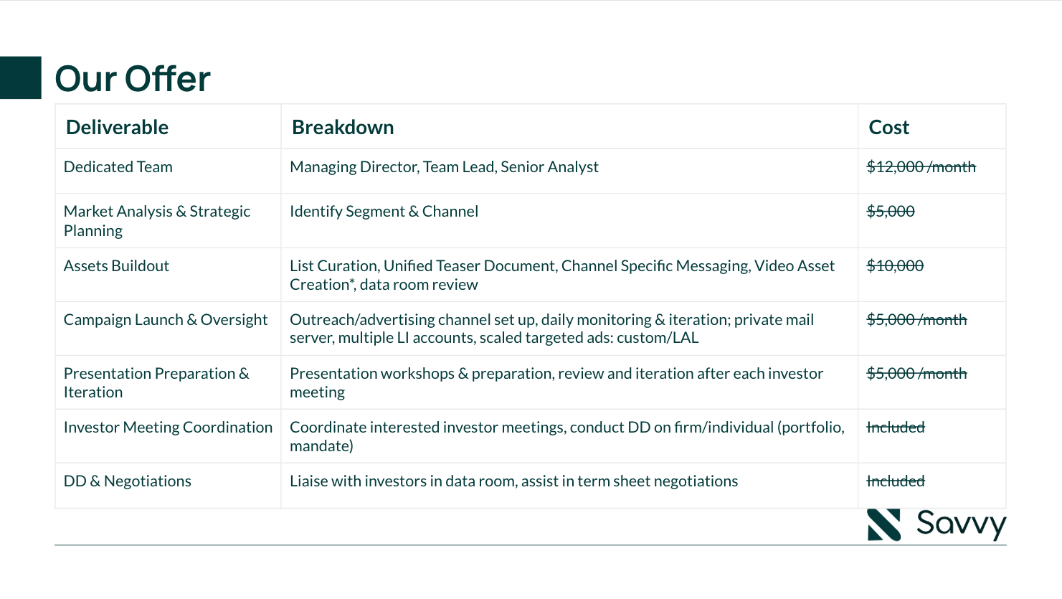

Slide 17
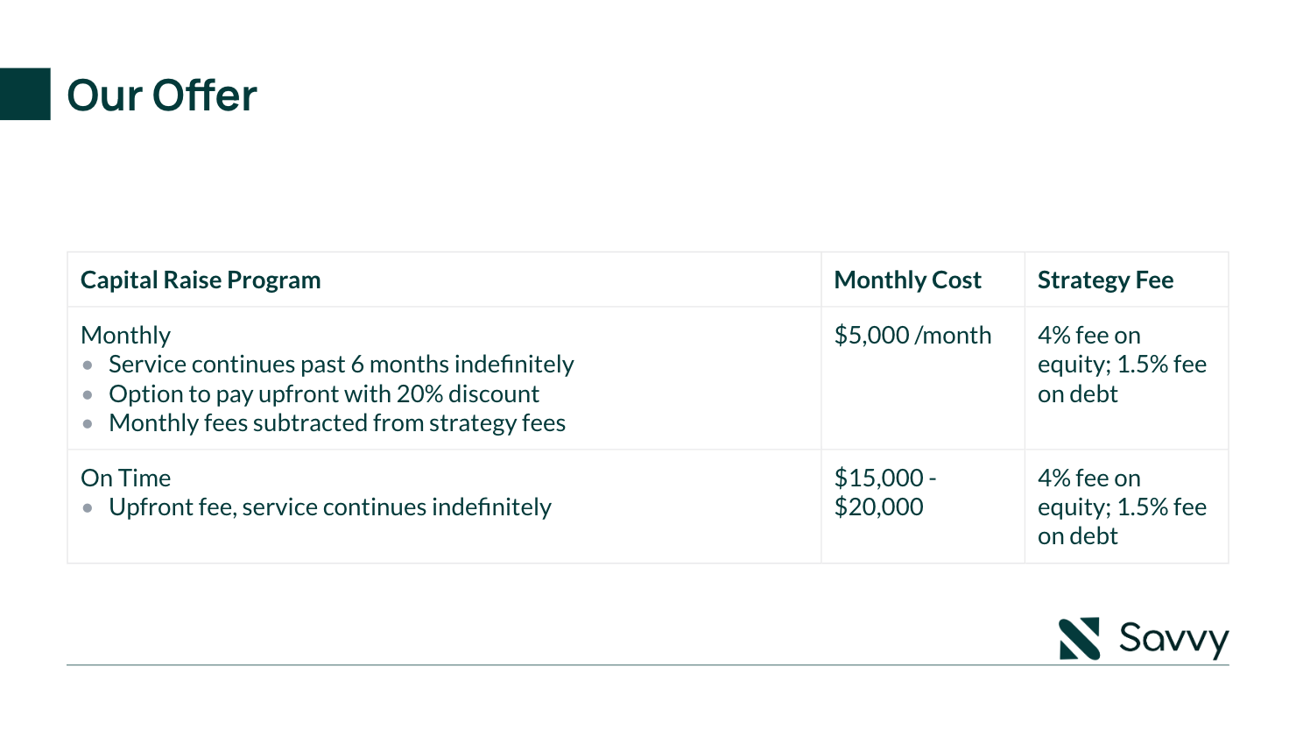
$5,000 -
$15,000

Slide 18
